Slide 1
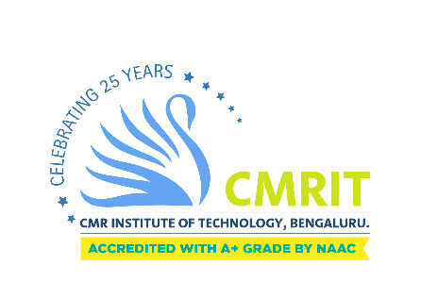
Museum Management System
Review - 1
Date : 22-12-23
1CR21CS151 Rohan N Karnkoti
1CR21CS214 Vismitha S
Under the guidance of:
Dr. Sanchari Saha
Department of Computer Science & Engineering
Notes:
1

Slide 2
Museum Management System
TITLE

Slide 3
MOTIVATION BEHIND CHOOSING THIS PROJECT
Museums are entrusted with safeguarding the tangible remnants of our past and present, but efficiently managing these vast collections can be a complex challenge. This project seeks to address this need by developing a comprehensive and user-friendly museum collection management system powered by MySQL.

Slide 4
OBJECTIVE OF THE PROJECT
The objective of a museum collection management project using MySQL would be to develop a comprehensive and efficient system for managing the museum's collection. This system should be designed to:
Simplify and streamline data management processes.
Improve the accuracy and availability of collection information.

Slide 5
Enhance collection accessibility for staff, researchers, and the public.
Facilitate collaboration and communication among different departments within the museum.
Provide insights into the collection and inform collection development strategies.

Slide 6
SOCIETAL BENEFIT
A well-managed museum collection can provide a variety of benefits to society, including:
Preserving and protecting cultural heritage: Museums play a vital role in preserving and protecting artifacts, artwork, and other objects that represent our cultural heritage for future generations.
Promoting understanding and appreciation of different cultures: Museum collections can offer valuable insights into different cultures and societies, promoting understanding and appreciation for diversity.

Slide 7
Supporting education and research: Museums provide resources and opportunities for education and research in various fields, from history and art to science and technology.
Enhancing tourism and economic development: Museums can attract visitors from around the world, contributing to local economies and creating jobs.
Promoting community engagement: Museums can serve as community centers, providing spaces for learning, social interaction, and cultural enrichment.

Slide 8
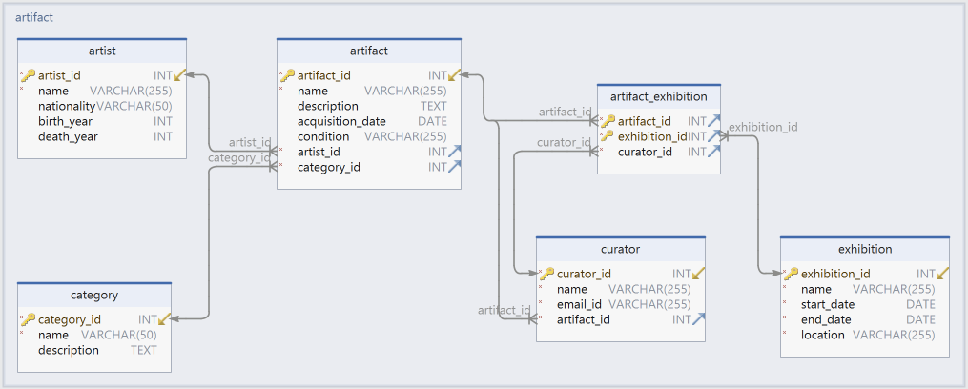
SCHEMA DIAGRAM

Slide 9
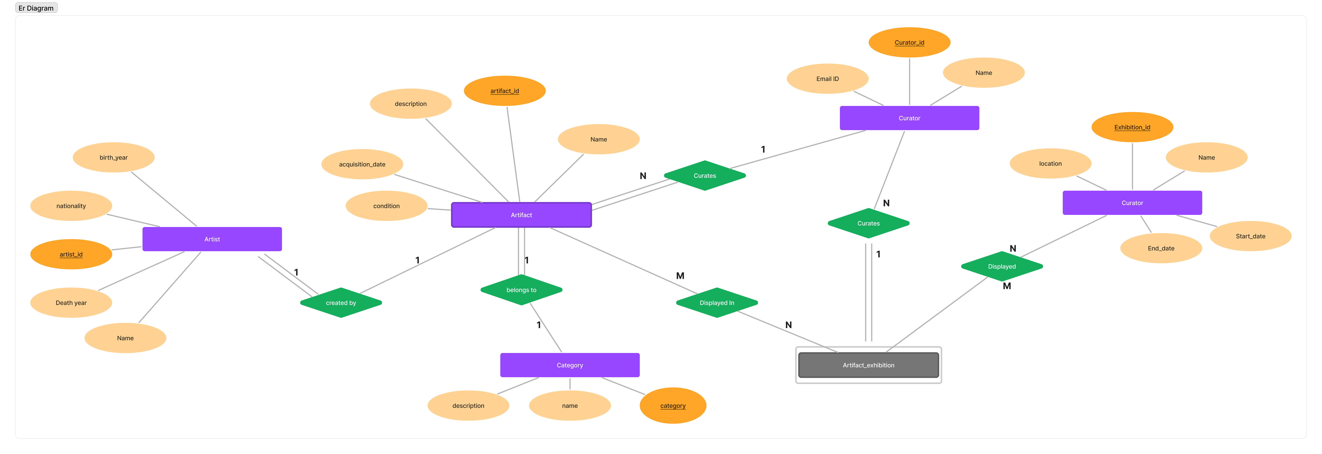
ER DIAGRAM

Slide 10
TOOLS TO BE USED
Front-end: Angular JS, Node JS, HTML
Back-end: MySQL

Slide 11
Thank you

